Slide 1


Image reconstruction
28/7/2024, TPPT project
Nuno C. Ferreira
ICNAS

Slide 2
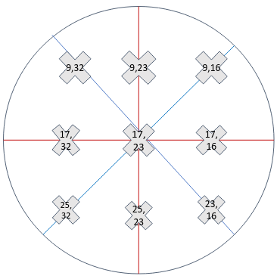
Summary
NEMA-like FWHM and FWTM for linear source in specific points of the FOV (9 positions):
(Note: the FBP reconstructed images were rotated 180 degrees to make it correspond to the positions in this diagram.)

Slide 3
Limitations
Limitation:
  Non-TOF only
    should not be very different with TOF
Differences relative to the NEMA standard
  Plot range should be approx 2x the FWHM
    this is according to the NEMA standard, but I disregarded that.
    I am plotting a fixed range (20mm on each side of the peak).
  Positions and type of source is not as specified in NEMA
    here I am using the 9 positions of the previous slide.

Slide 4
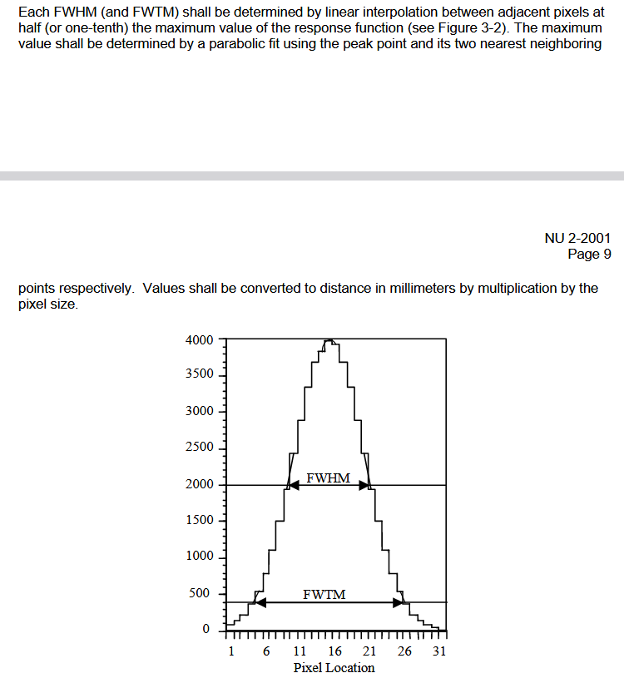
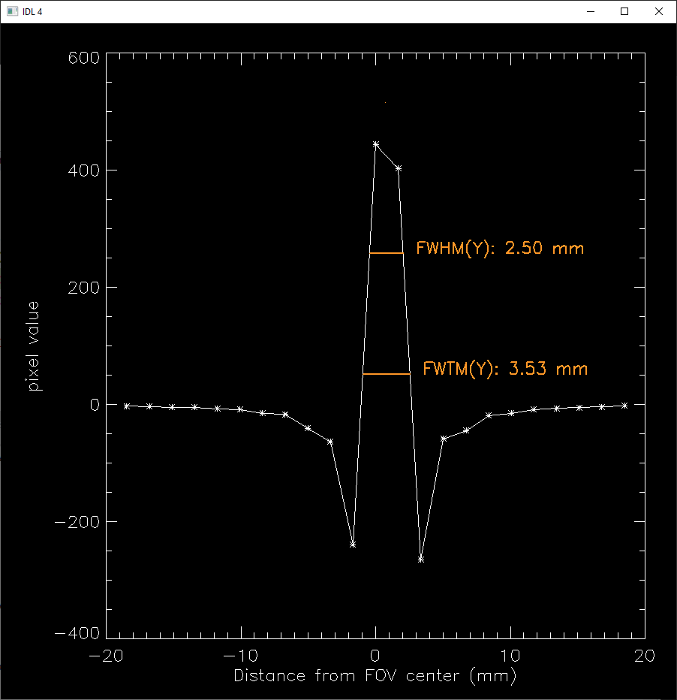
This NEMA requirement has now been implemented:
Parabolic fit to find the peak based on the max and one neighbor on each side
For reference, if needed, the position of the peak that was found using the parabolic fit is shown as a very subtle orange point in the plots. Sometimes it is indistinguishable from the maximum of the plot.
these undershoots in the Y profiles are mainly due to the incomplete ring of TPPT, which is inconsistent with what the FBP algorithm expects (full-ring geometry)

Slide 5
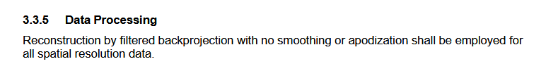
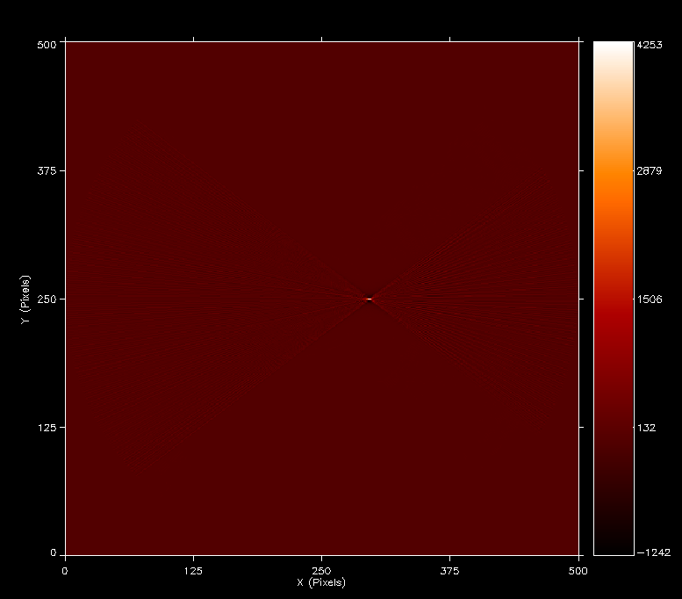
Method
Data was reconstructed with FBP
(no apodization or smoothing)
  listmode data was binned into non-oblique sinograms (no rebinning was used). These sinograms were added, resulting in one non-oblique sinogram.
The Y profiles across the peak have negative values
  they are due to the incomplete ring geometry (the FBP algorithm expects data from a full ring geometry)
Detector head
Detector head
Example of FBP reconstruction

Slide 6
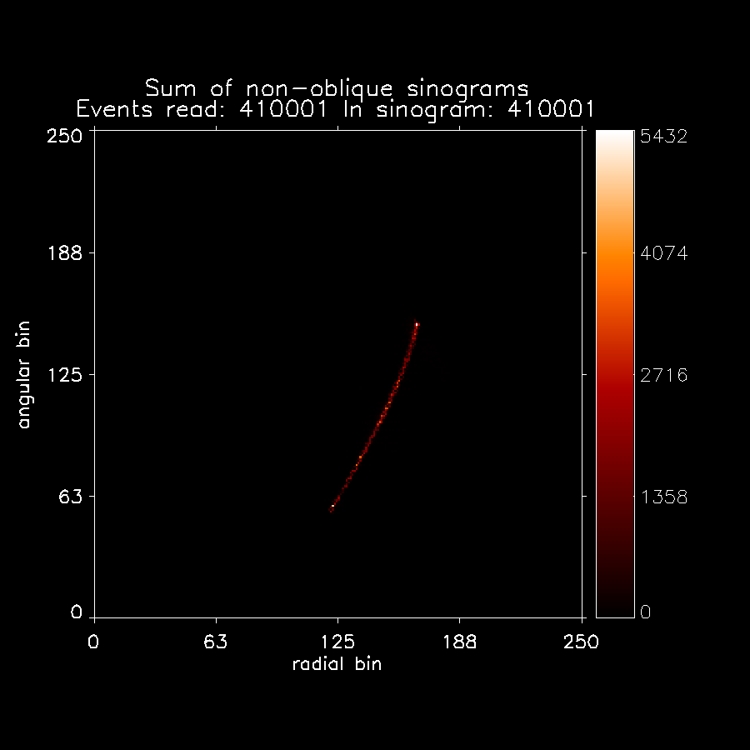
Regarding the sinograms:
Due to the limited-angle geometry, they are incomplete, i.e. not all angular positions have data. Example:
(a line source perpendicular to the image plane would generate a sinosoidal line in the sinogram, but due to the TPPT limited-angle geometry we only see part of it.)

Slide 7
Regarding the FBP algorithm:
No zero-padding was applied, to conform to the NEMA standard.
  in yesterdays’ slides, zero padding was being applied in my FBP implementation.

Slide 8
Results
Summary of the FWHM and FWTM obtained with different image sizes
(FBP images were reconstructed with: 200x200, 300x300, 400x400 and 500x500 pixels)

Slide 9
Summary
All the best FWHM and FWTH were obtained with the 500x500 images.
  Best FWHM_y: 0.71 mm
  Best FWHM_x: 1.61 mm

Slide 10
Number of pixels in reconstructed image (NxN)
due to noise in the image

Slide 11
Results
200x200 pixels FBP reconstructed images
X and Y FWHM and FWTM
Worse spatial resolutions are expected, but less image noise

Slide 12
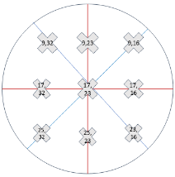
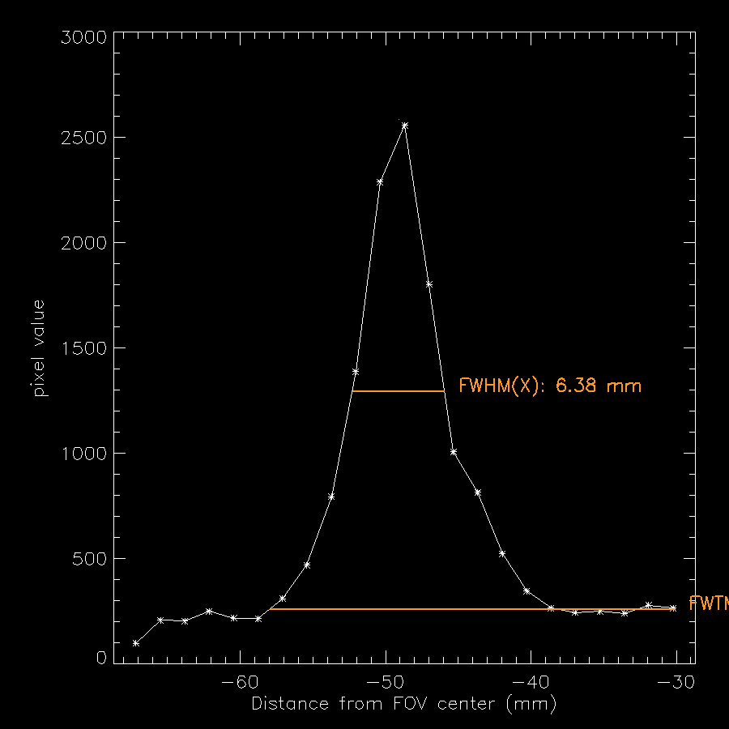
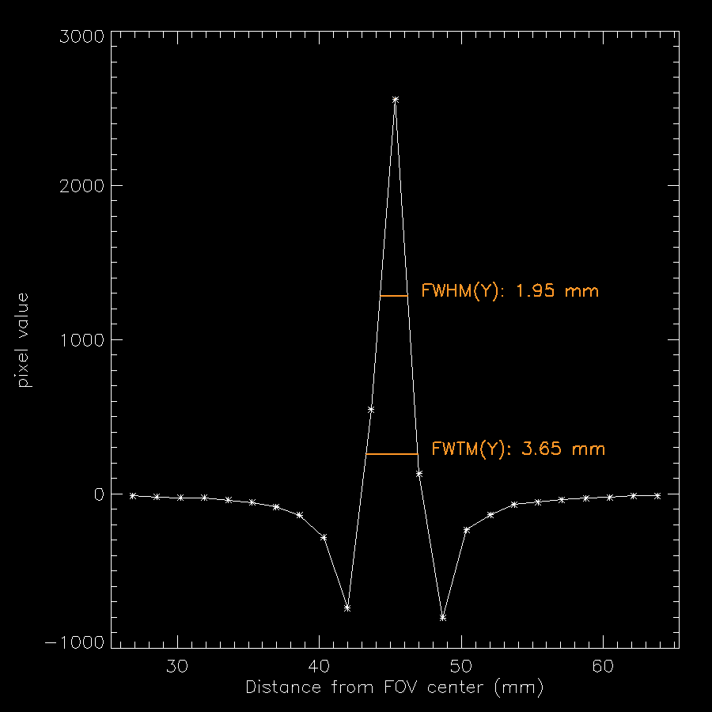

Slide 13
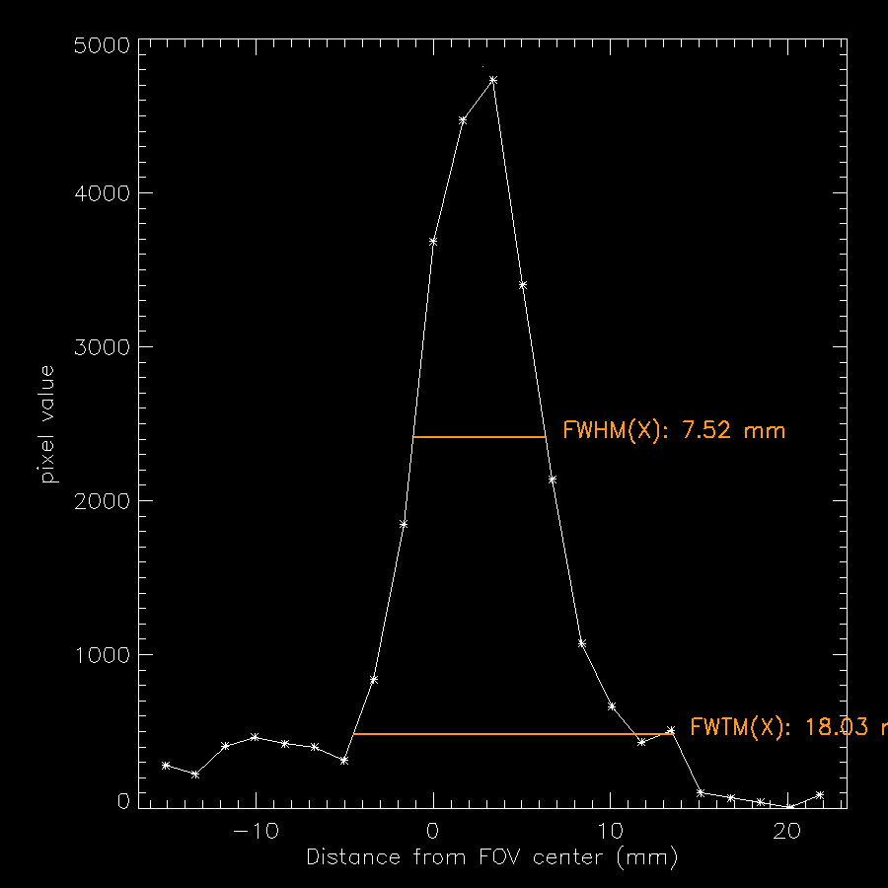
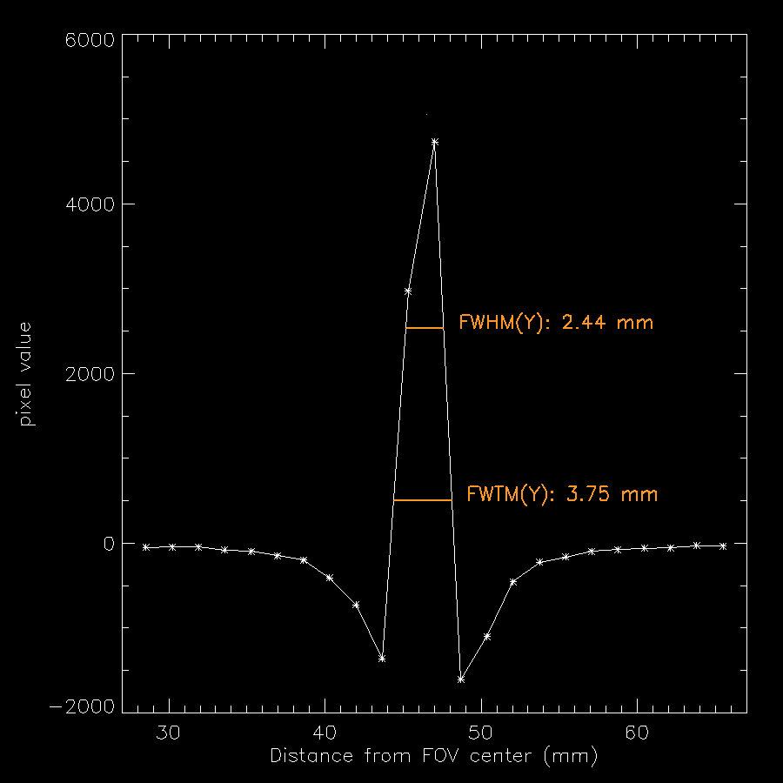

Slide 14
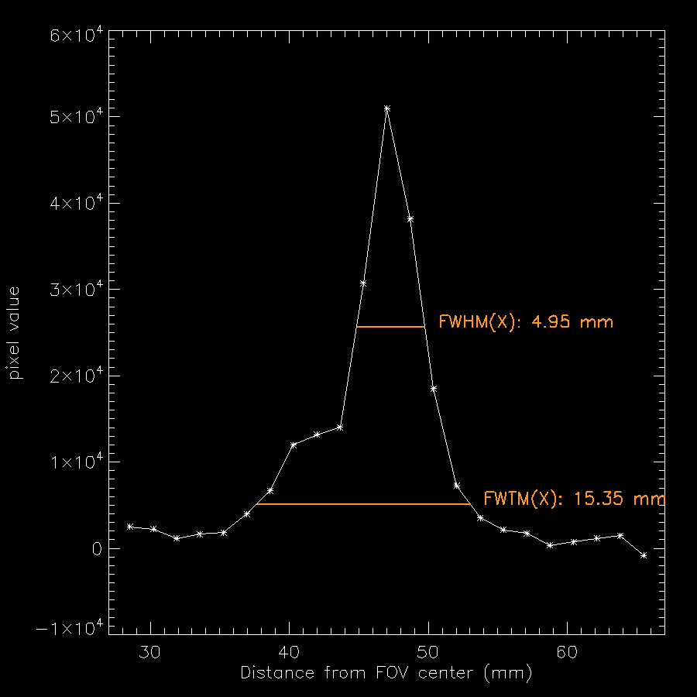
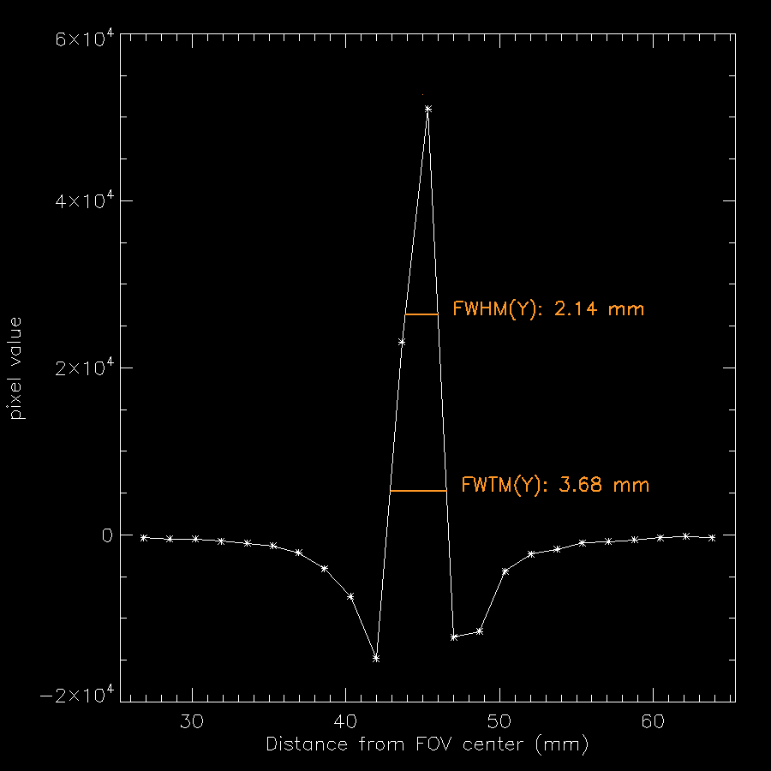

Slide 15
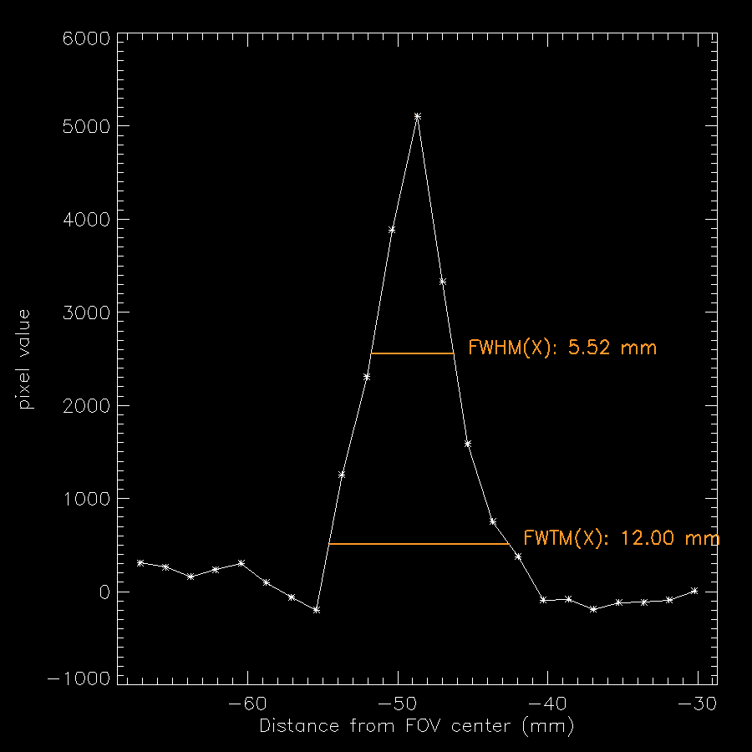
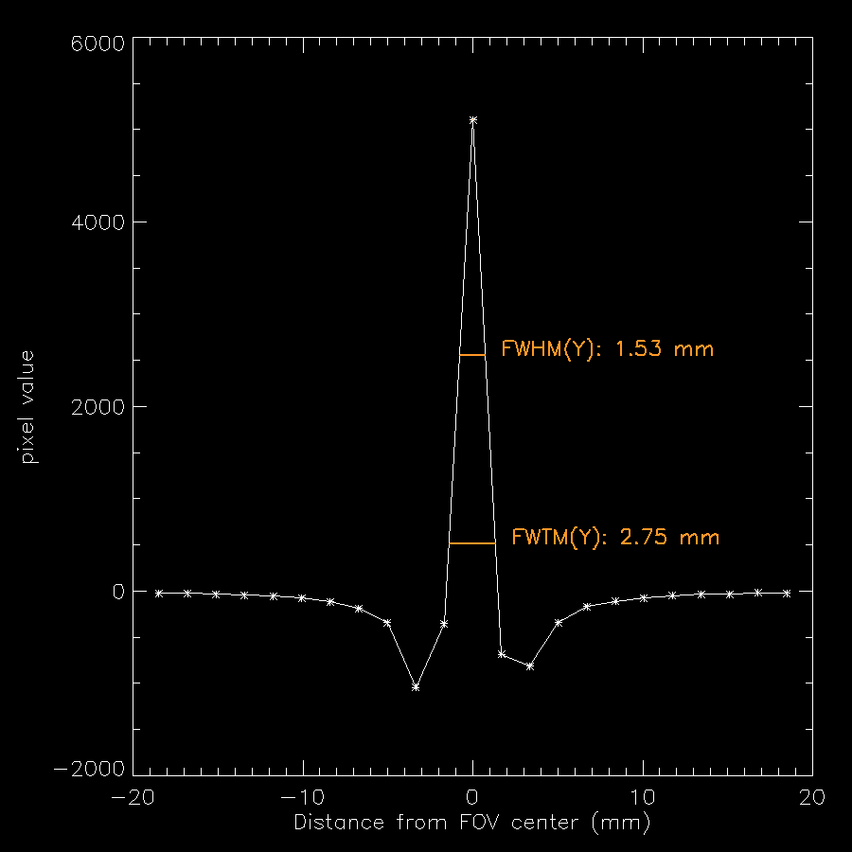

Slide 16
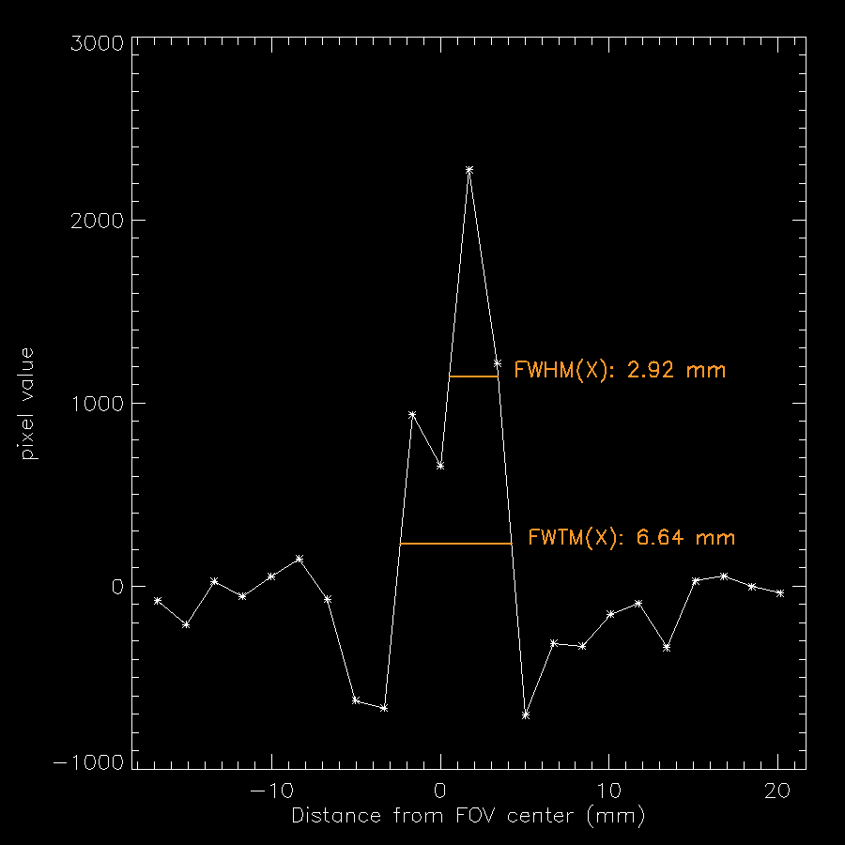
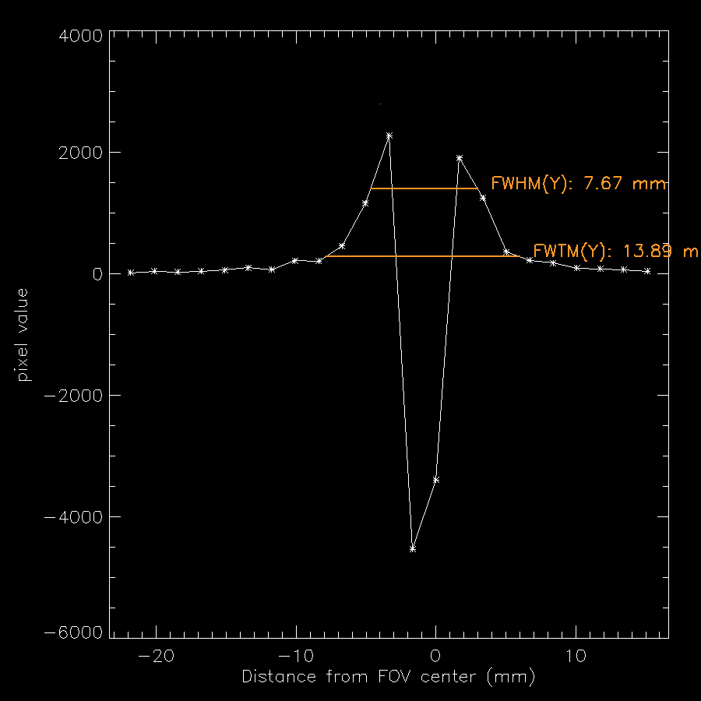

Slide 17
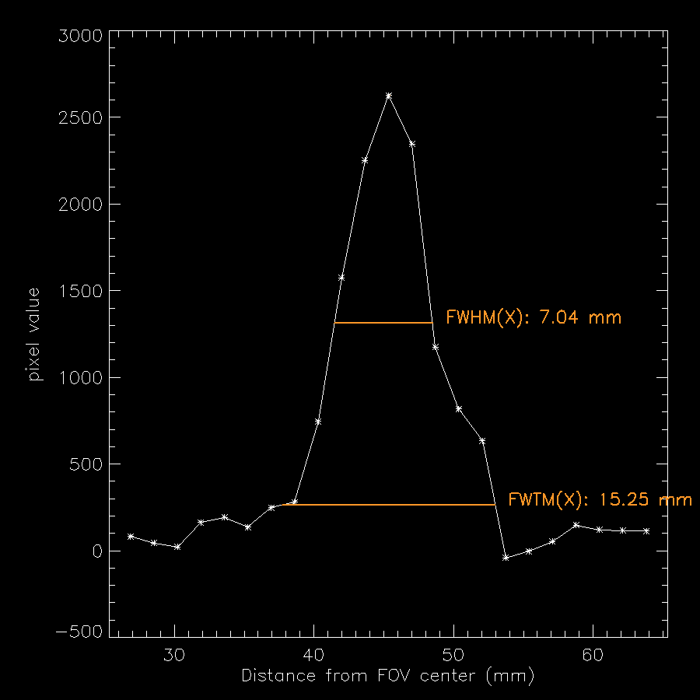
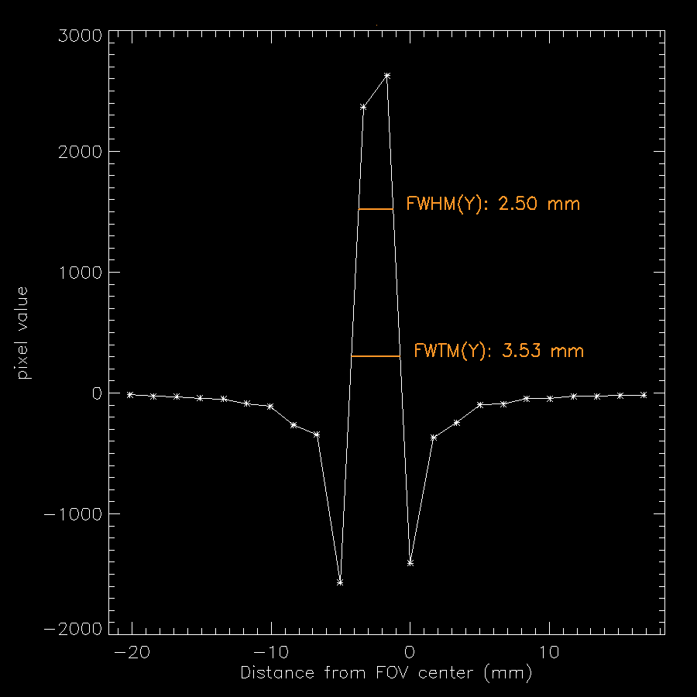

Slide 18
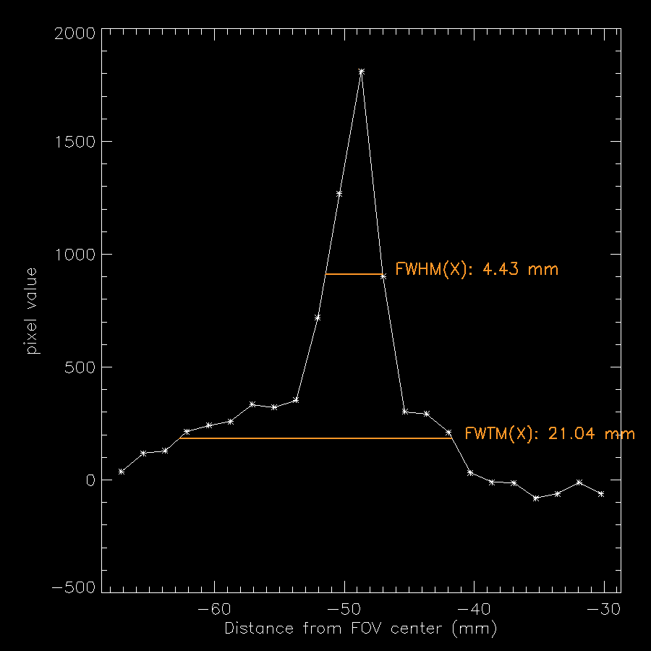
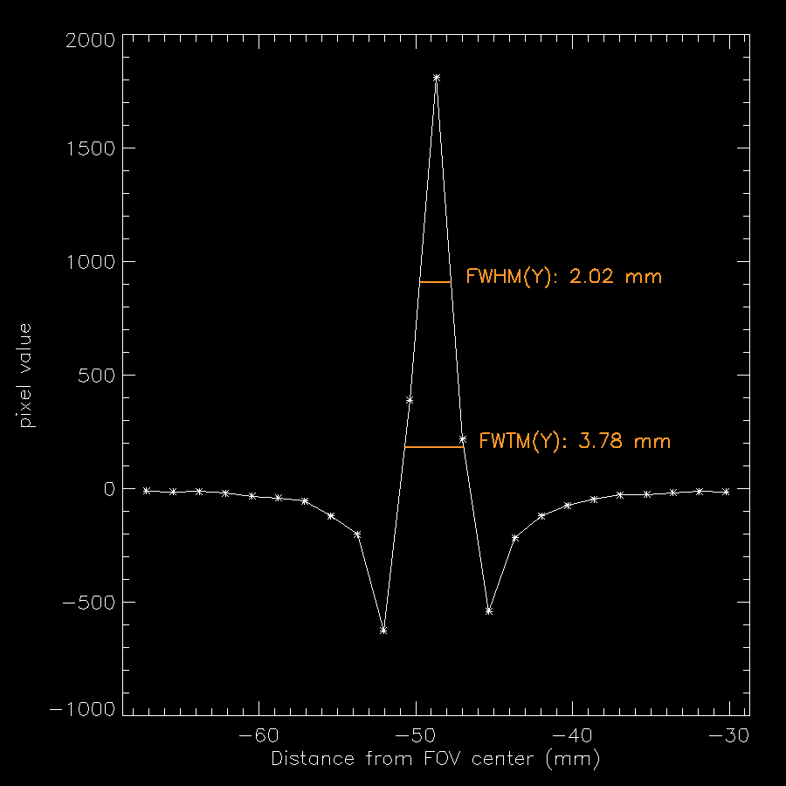

Slide 19
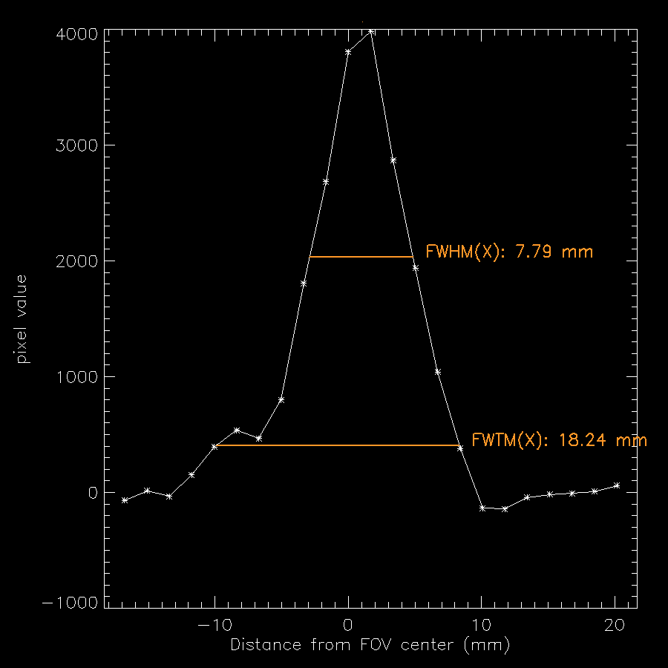
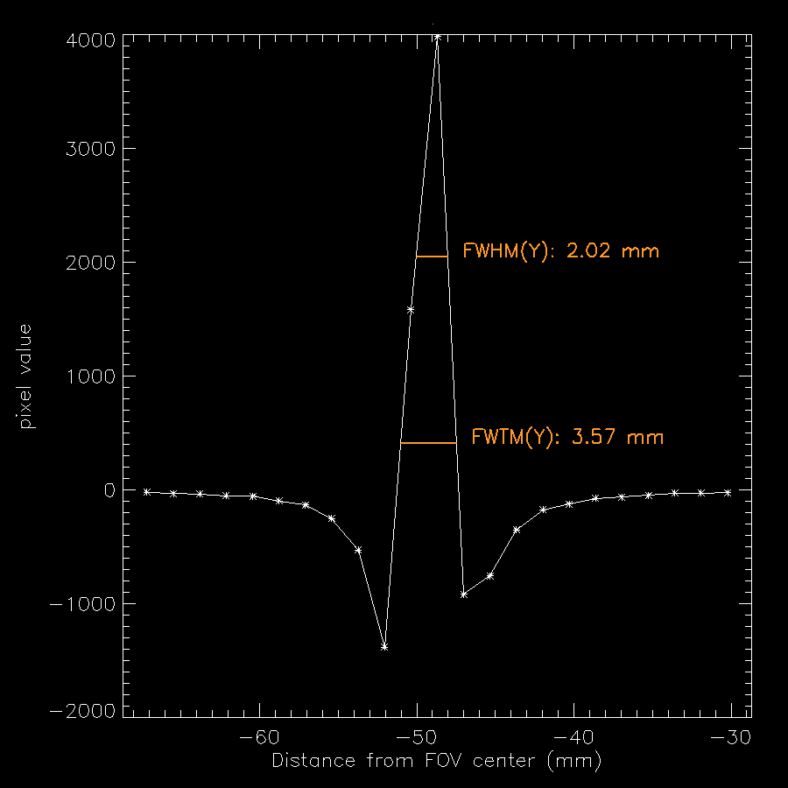

Slide 20
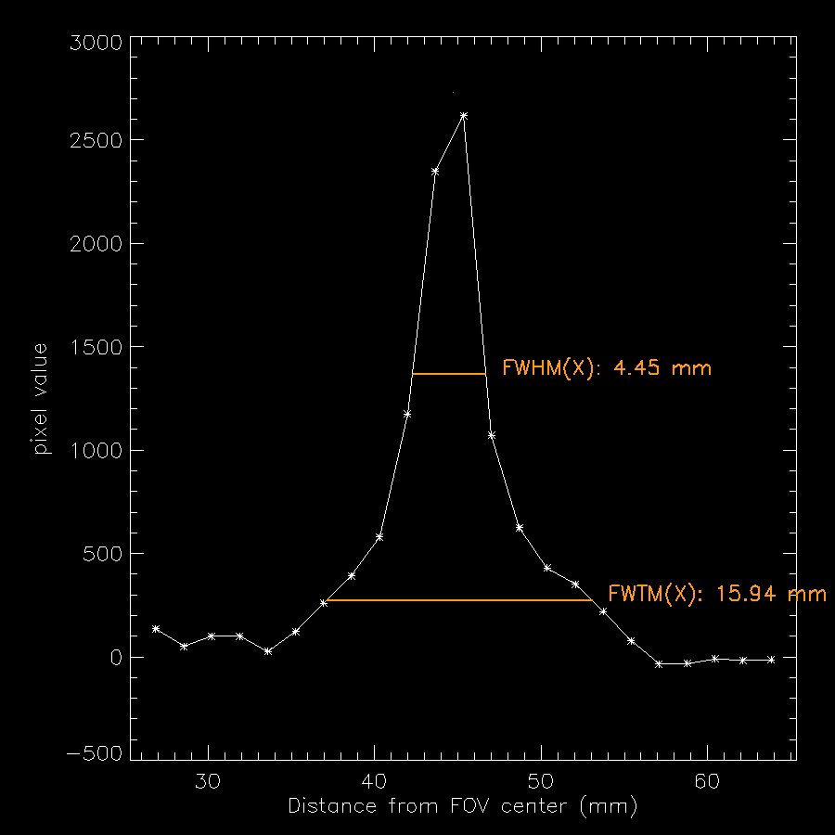
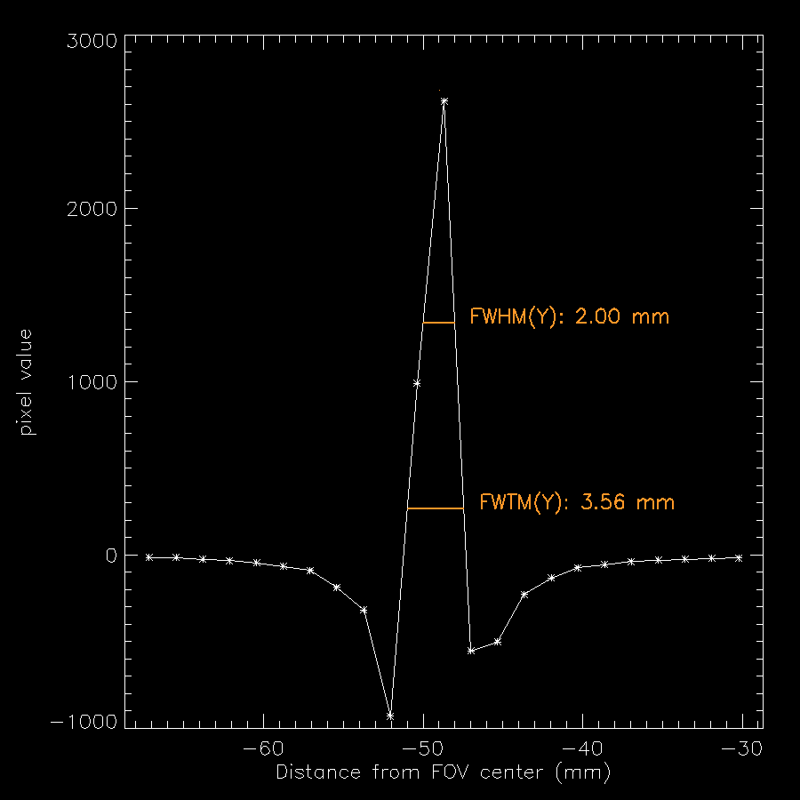

Slide 21
Results
500x500 pixels FBP reconstructed images
X and Y FWHM and FWTM
Better spatial resolutions are expected, but more image noise

Slide 22
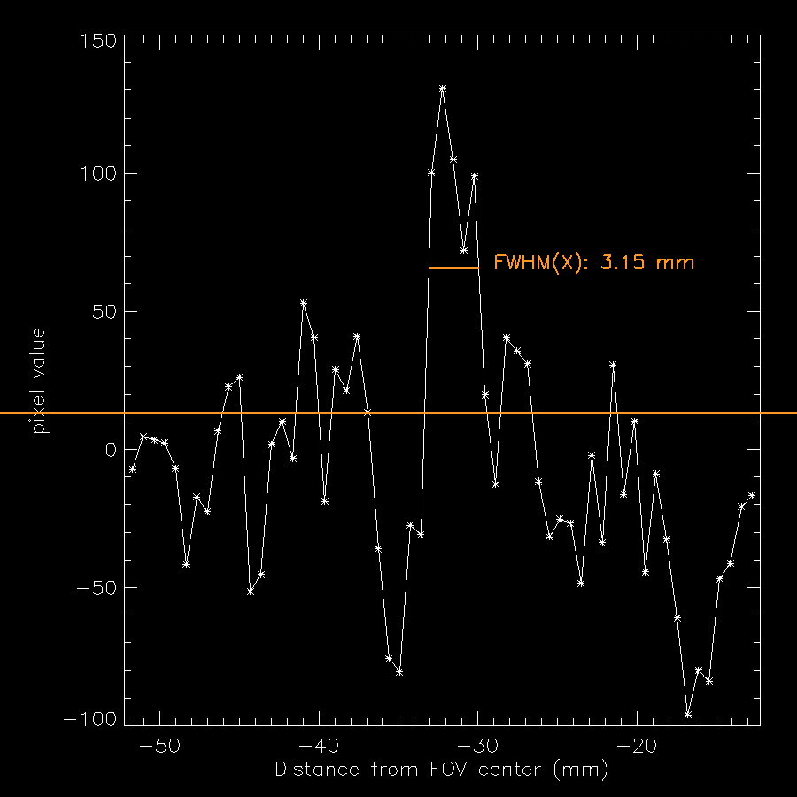
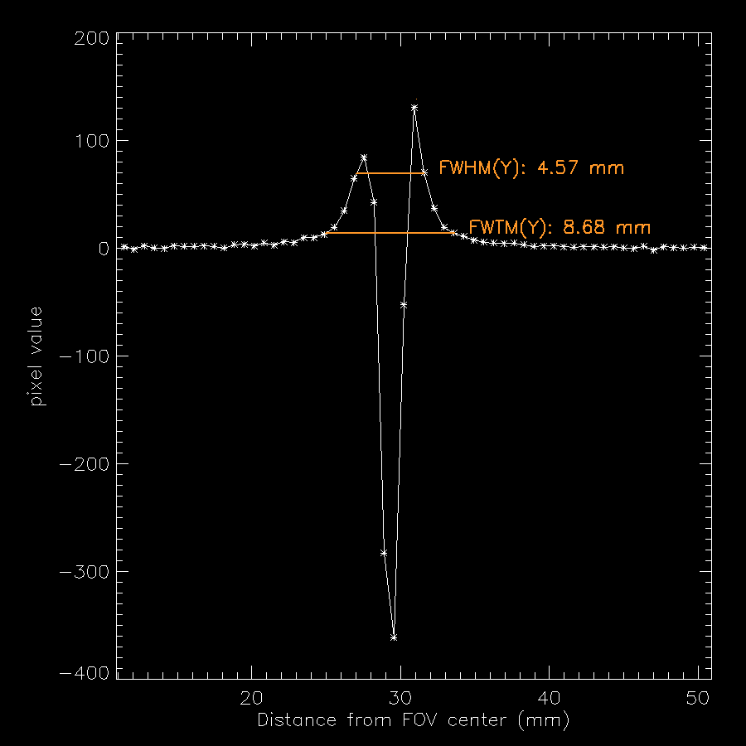

Slide 23
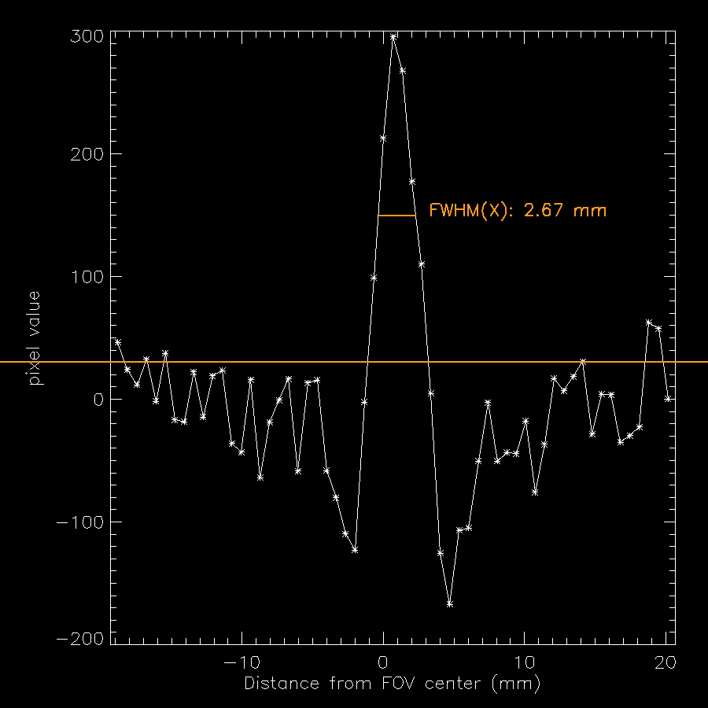
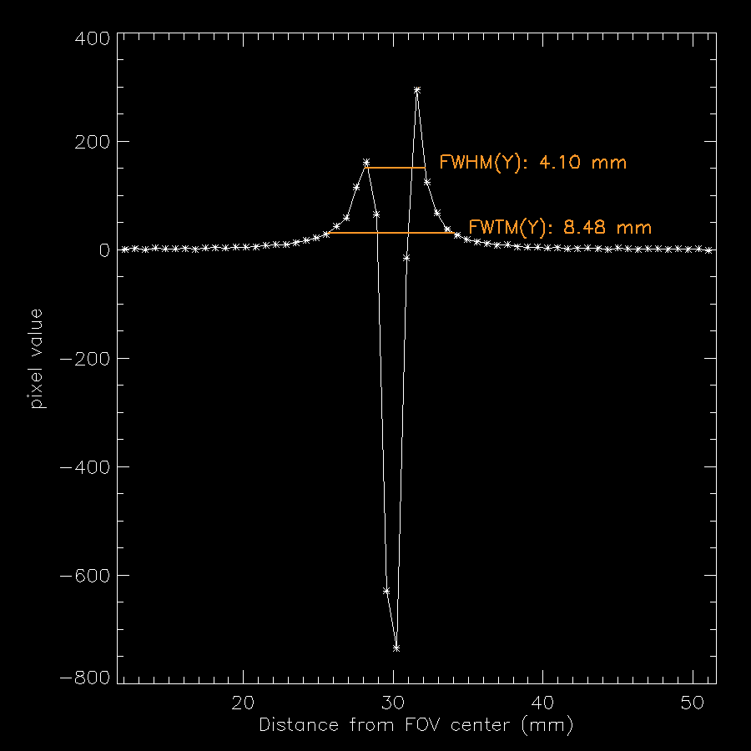

Slide 24
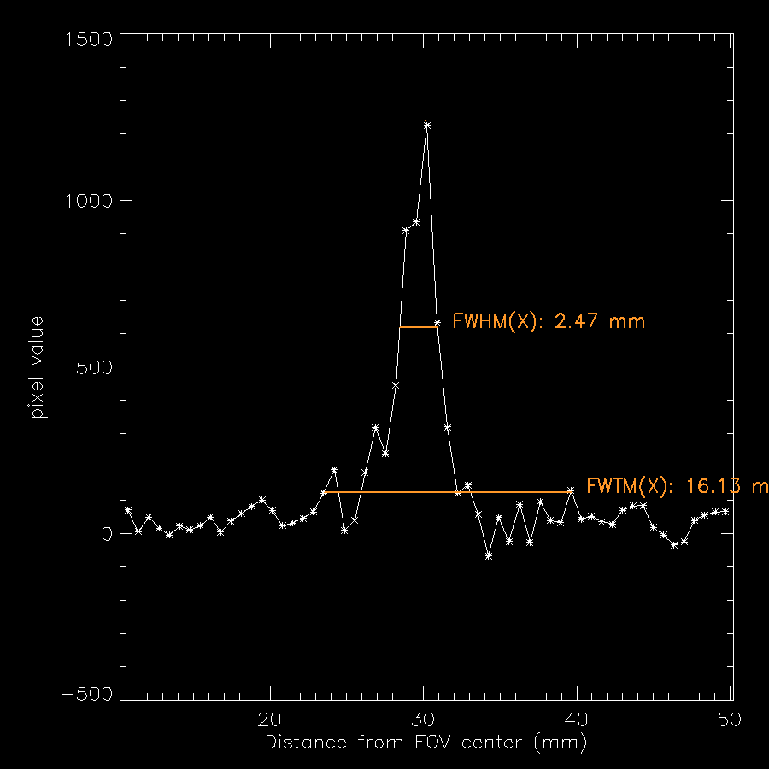
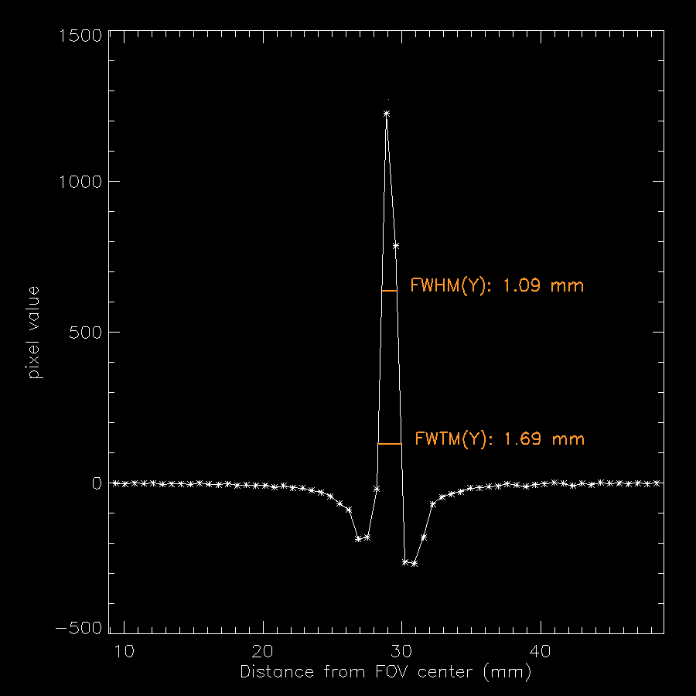

Slide 25
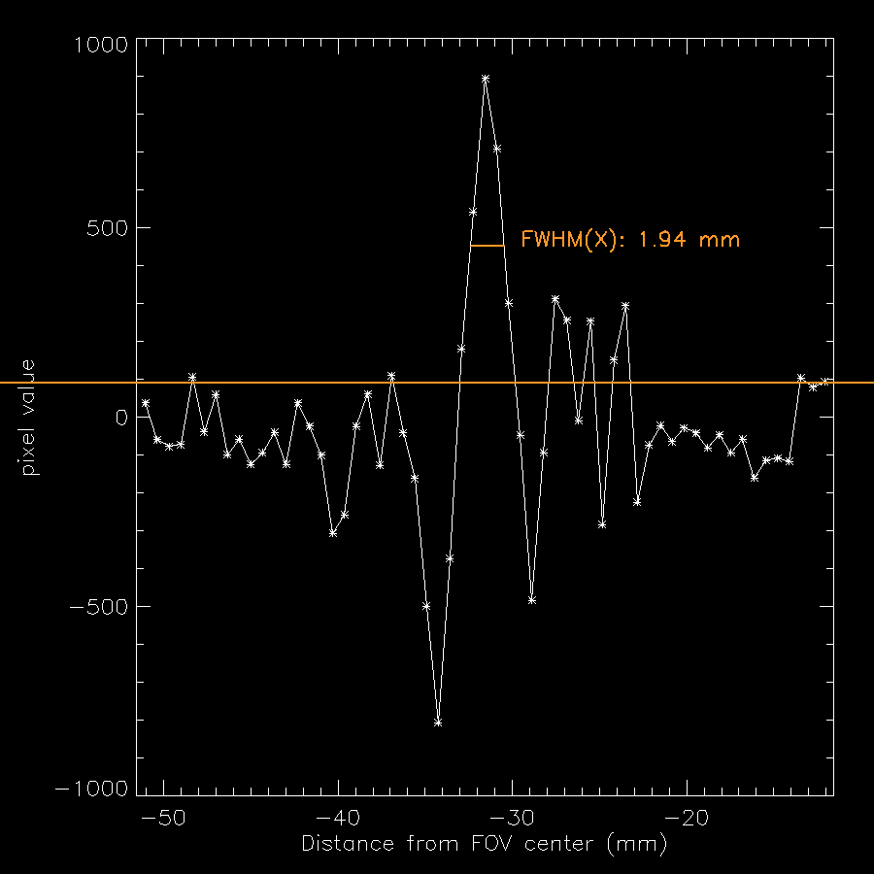
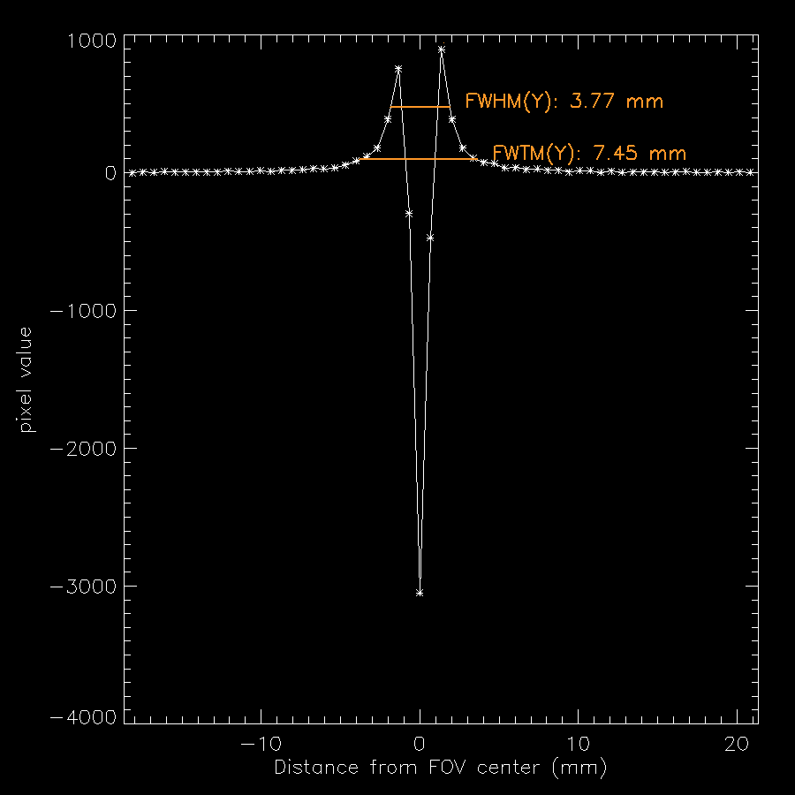

Slide 26
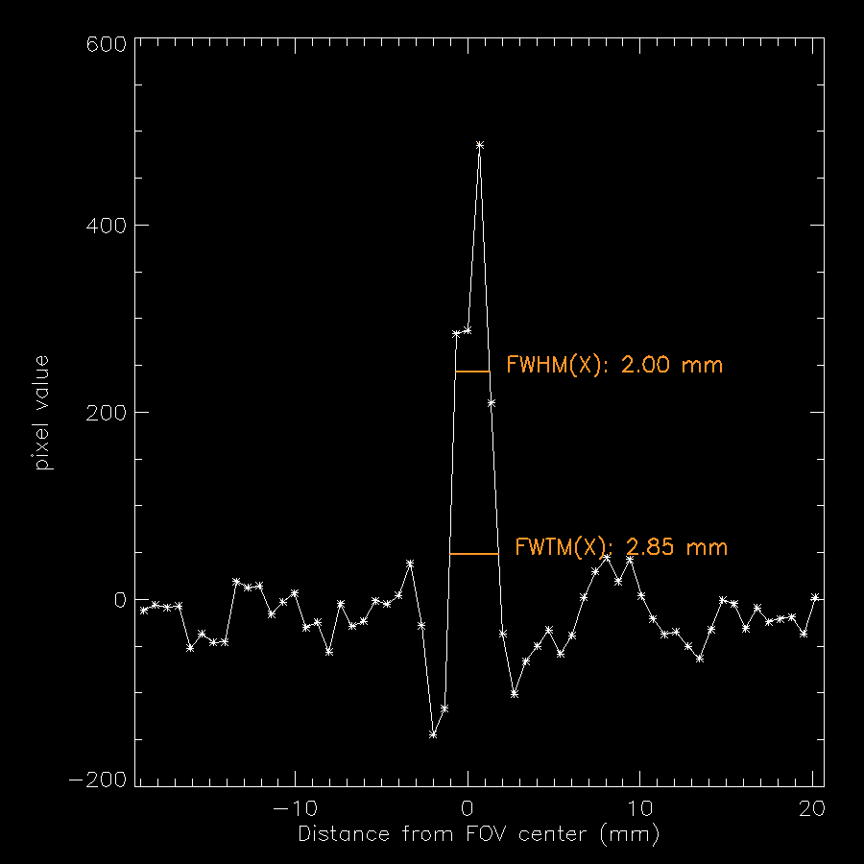
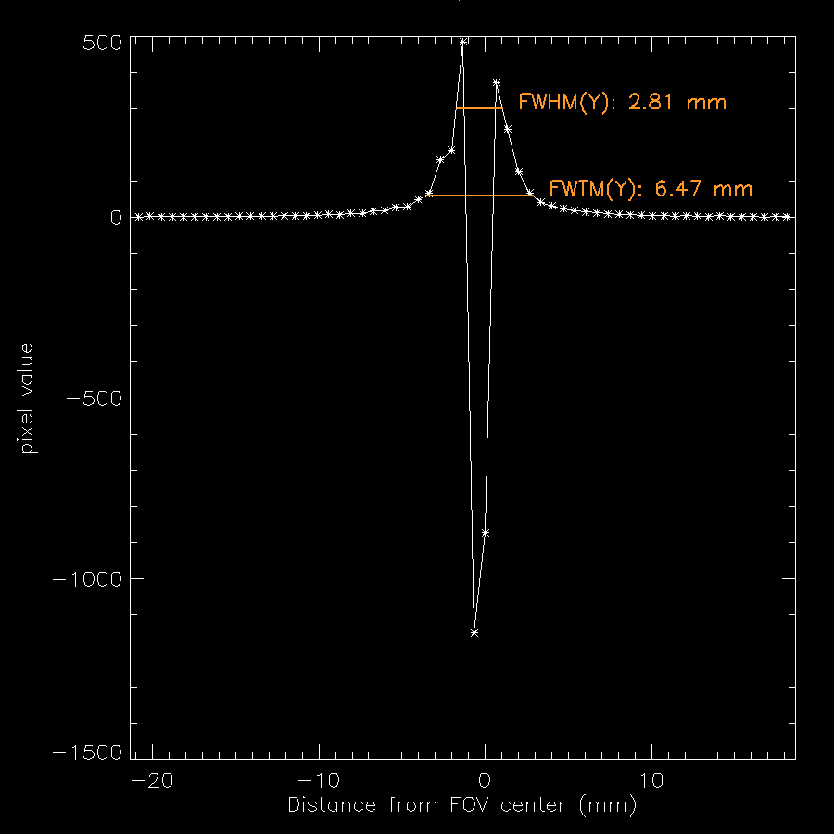

Slide 27
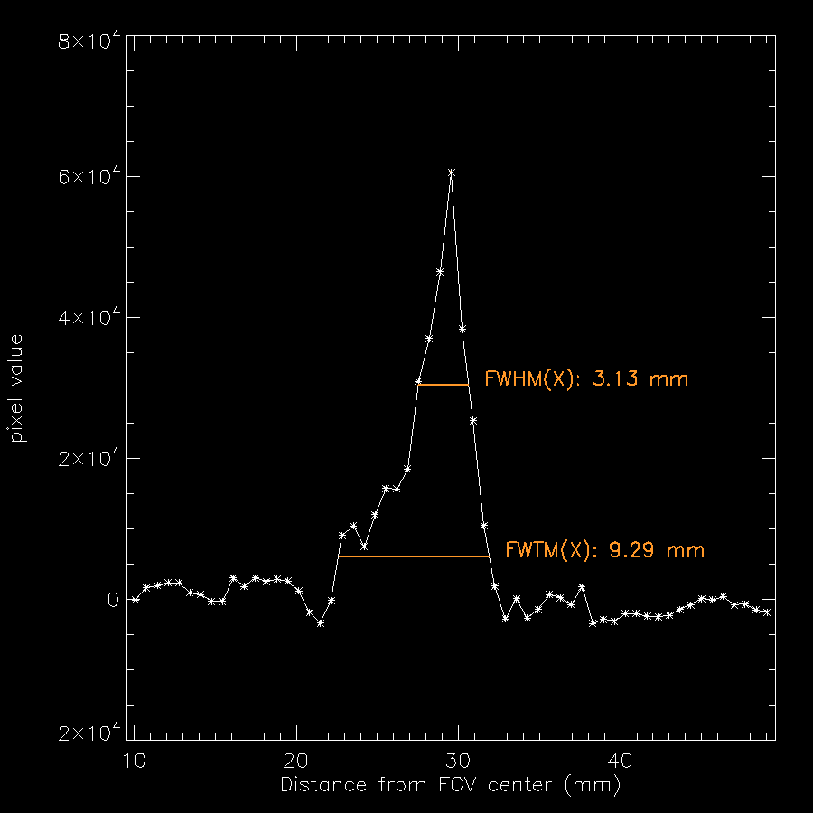
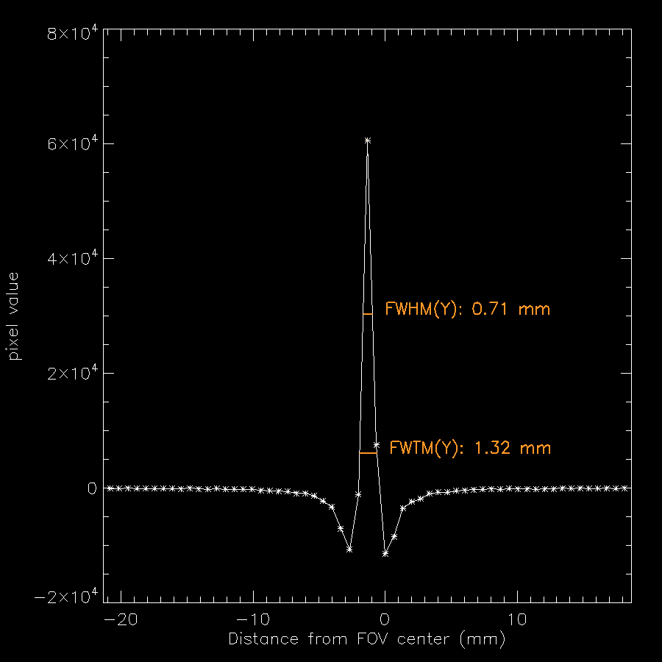
Best FWHM_y

Slide 28
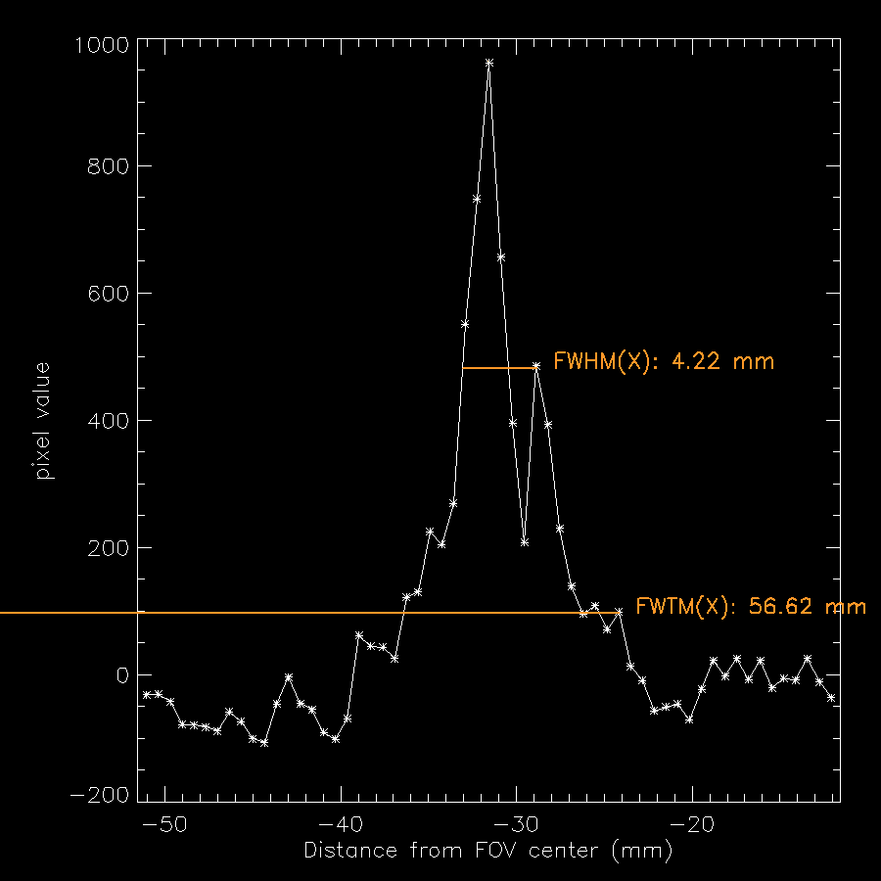
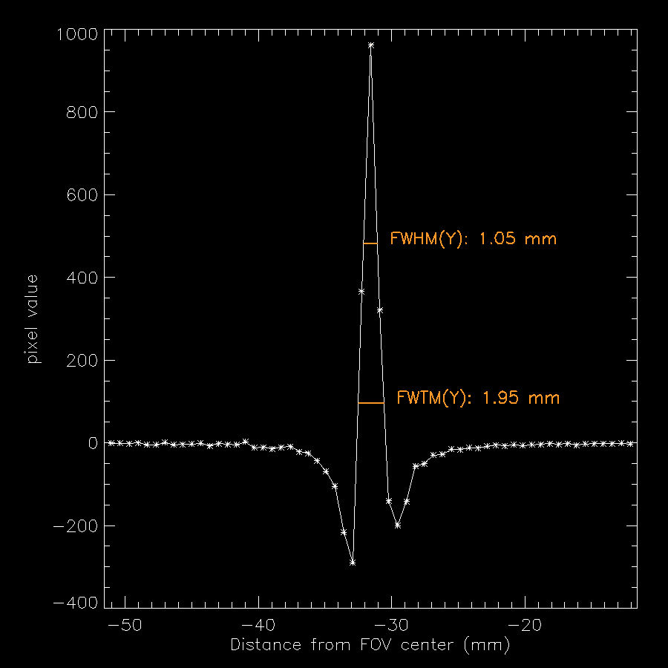

Slide 29
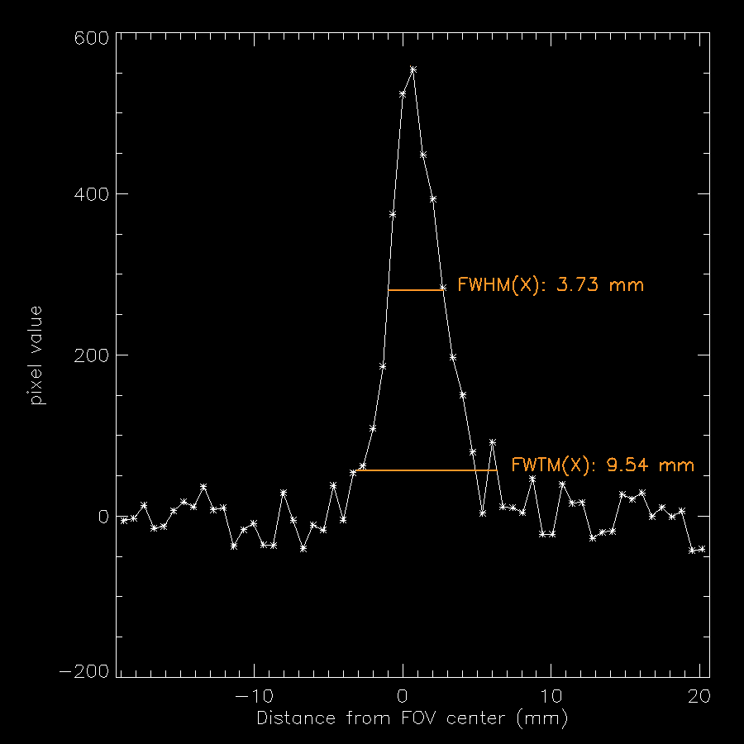
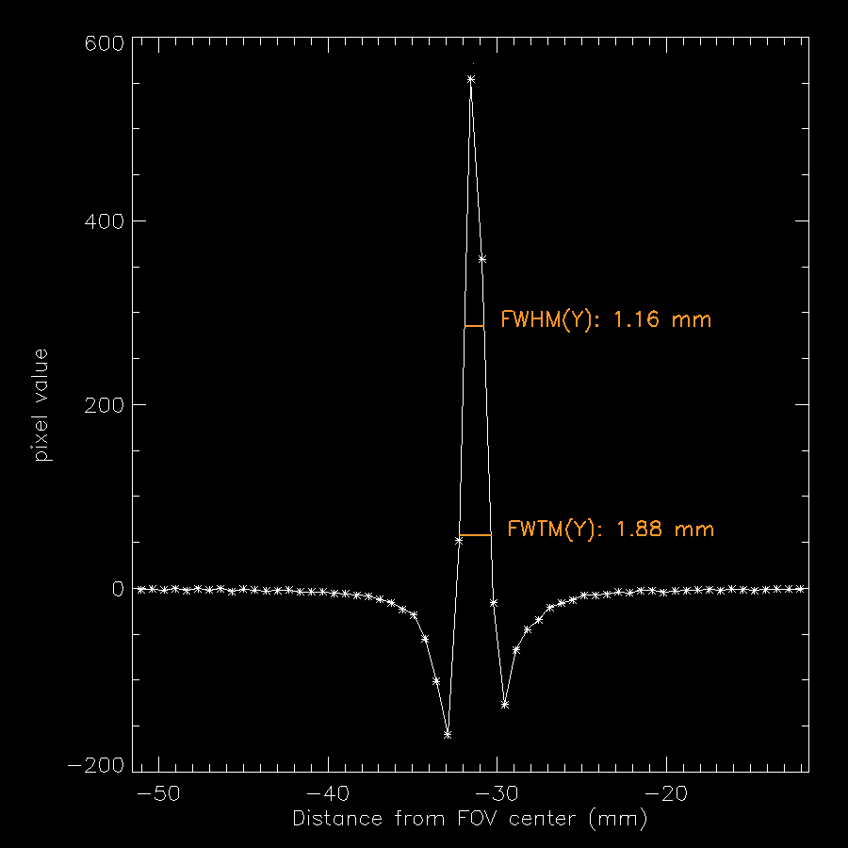

Slide 30
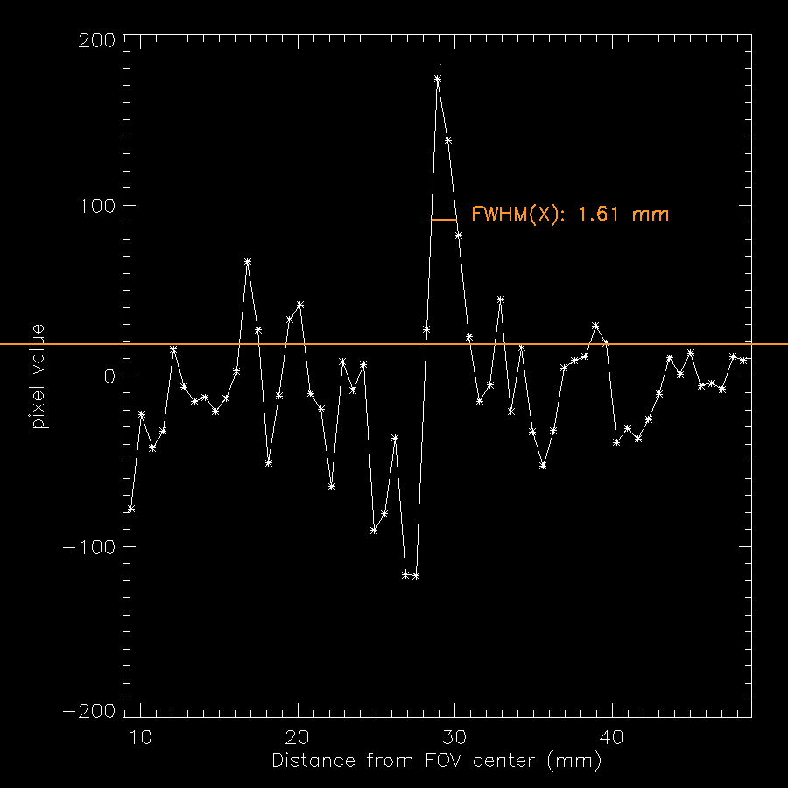
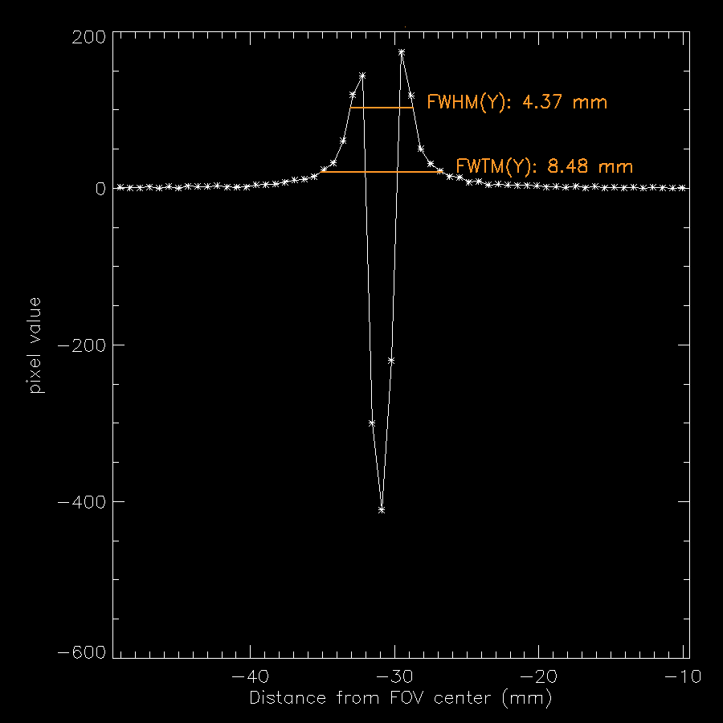
Best FWHM_x

Slide 31
Results
200x200 pixels
sinograms and reconstructed images (FPB)
Other image sizes (300x300, 400x400, 500x500) are available in a .zip file.

Slide 32
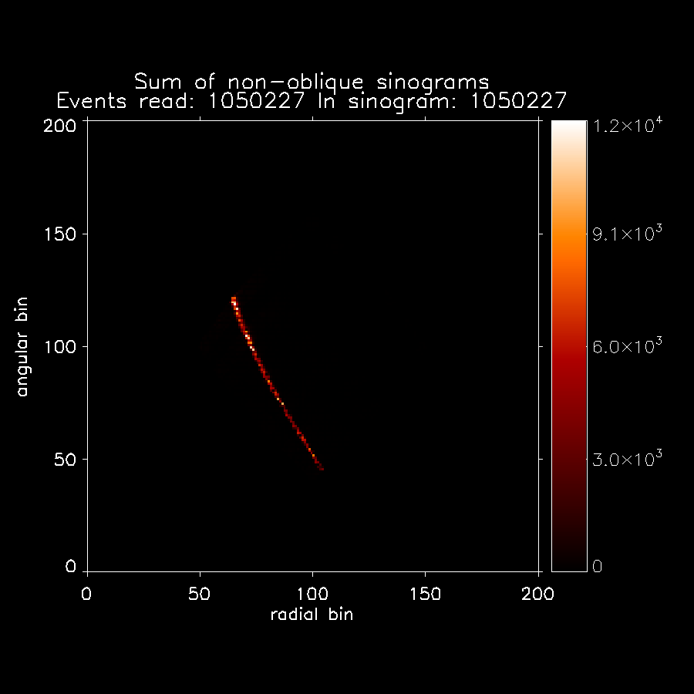
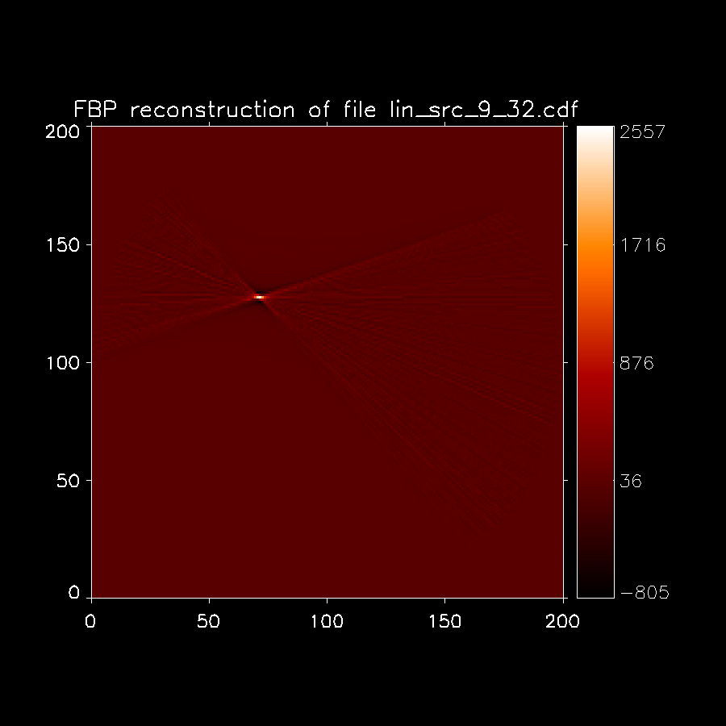
the reconstructed image was rotated 180 degrees to correspond to the diagram →

Slide 33
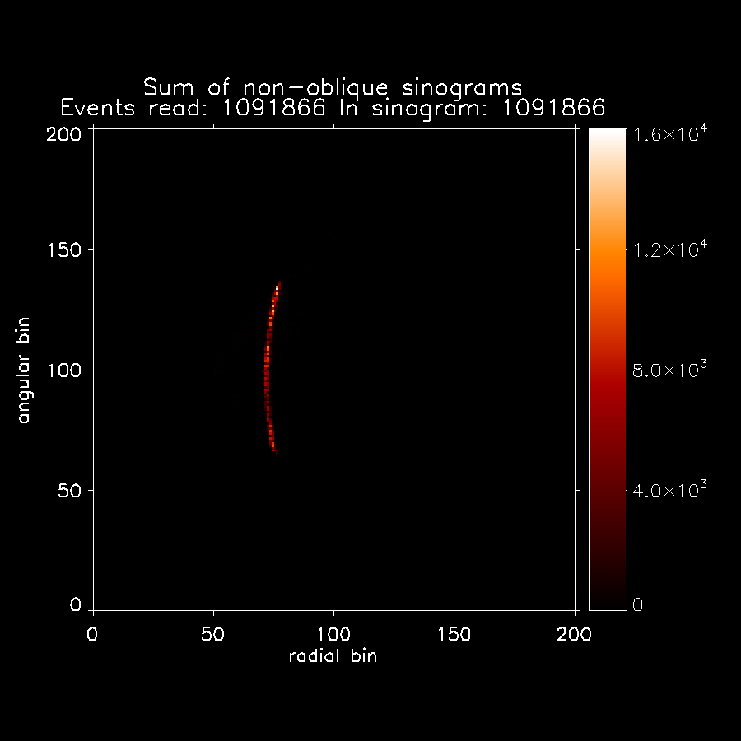
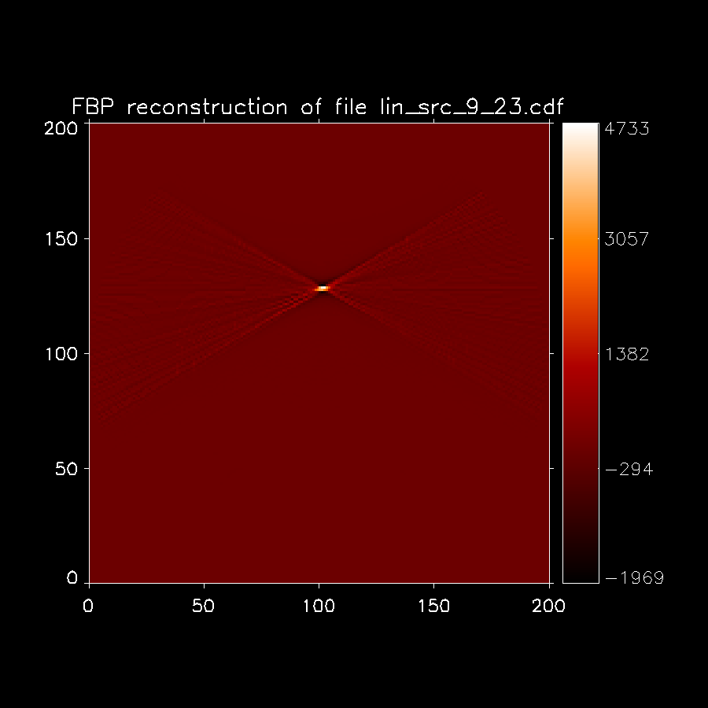
the reconstructed image was rotated 180 degrees to correspond to the diagram →

Slide 34
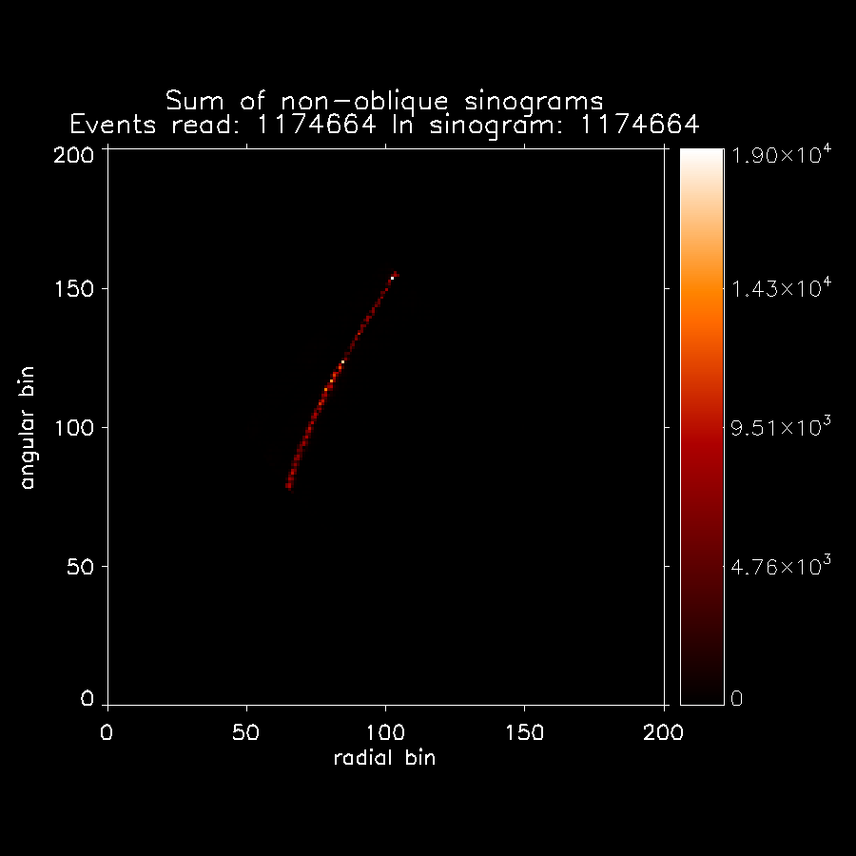

the reconstructed image was rotated 180 degrees to correspond to the diagram →

Slide 35
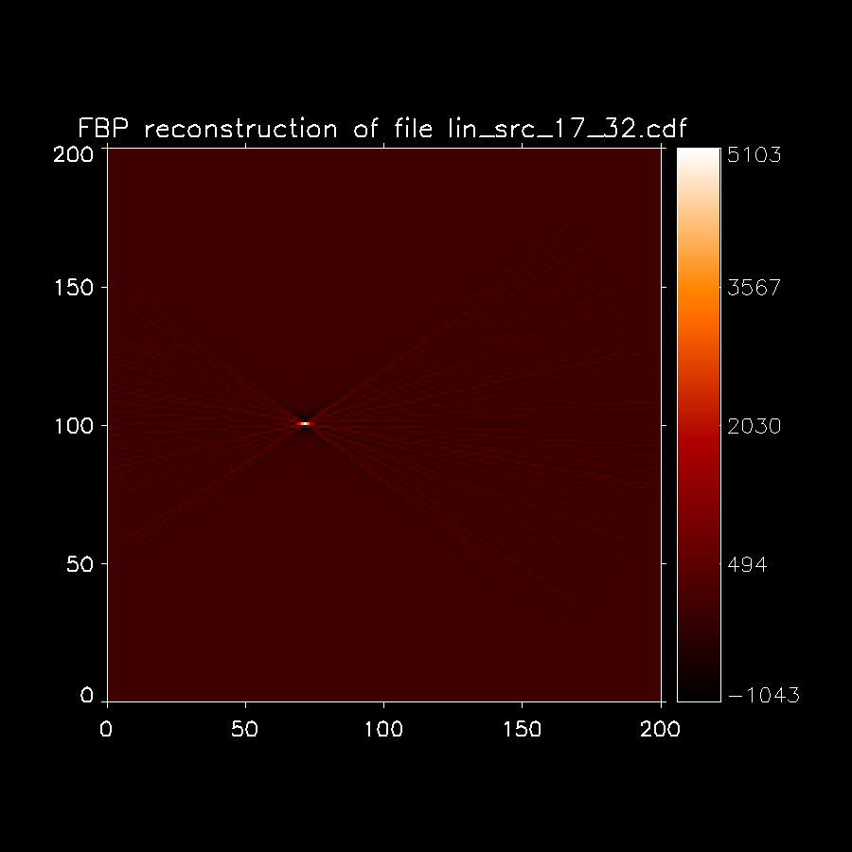

the reconstructed image was rotated 180 degrees to correspond to the diagram →

Slide 36

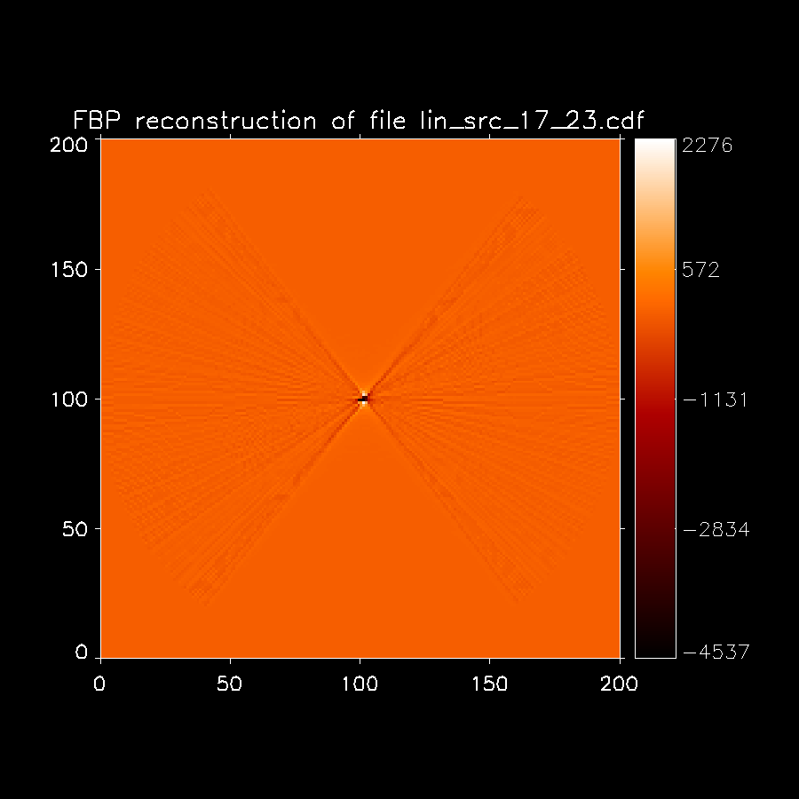
the reconstructed image was rotated 180 degrees to correspond to the diagram →

Slide 37


the reconstructed image was rotated 180 degrees to correspond to the diagram →

Slide 38


the reconstructed image was rotated 180 degrees to correspond to the diagram →

Slide 39


the reconstructed image was rotated 180 degrees to correspond to the diagram →

Slide 40


the reconstructed image was rotated 180 degrees to correspond to the diagram →

Slide 41
Results
500x500 pixels
sinograms and reconstructed images (FPB)
Other image sizes (300x300, 400x400, 500x500) are available in a .zip file.

Slide 42


the reconstructed image was rotated 180 degrees to correspond to the diagram →

Slide 43


the reconstructed image was rotated 180 degrees to correspond to the diagram →

Slide 44


the reconstructed image was rotated 180 degrees to correspond to the diagram →

Slide 45


the reconstructed image was rotated 180 degrees to correspond to the diagram →

Slide 46


the reconstructed image was rotated 180 degrees to correspond to the diagram →

Slide 47


the reconstructed image was rotated 180 degrees to correspond to the diagram →

Slide 48


the reconstructed image was rotated 180 degrees to correspond to the diagram →

Slide 49


the reconstructed image was rotated 180 degrees to correspond to the diagram →

Slide 50


the reconstructed image was rotated 180 degrees to correspond to the diagram →

Slide 51
Results
Effect of the number of pixels on the sinograms and reconstructed images (FPB):
one example.

Slide 52
the reconstructed image was rotated 180 degrees to correspond to the diagram →

Slide 53

the reconstructed image was rotated 180 degrees to correspond to the diagram →

Slide 54

the reconstructed image was rotated 180 degrees to correspond to the diagram →

Slide 55
the reconstructed image was rotated 180 degrees to correspond to the diagram →

Slide 56

Discussion
1 cm vertically from the center
To report the NEMA spatial resolution, we should have a point source in the positions shown in the figure. We have positions at center FOV and at 3 cm from the center FOV, along X and Y (it is not very different).
Our sources are different and the positions were also different. So, we are not yet reporting NEMA spatial resolutions, but figures that indicate what we can expect in close to NEMA conditions.
I have summed the data corresponding to all the planes (line source; NEMA requires point source). So, I did not calculate the spatial resolution for different positions axially (NEMA would give two values, at center and at ¼ axial FOV). I can give those different axial values, if needed, but the conditions are not NEMA (line source instead of point source).

